Slide 1

Impact of Online and Offline Education on Student Performance and Engagement
This project explores the effects of online and offline education on student outcomes. We'll analyze performance metrics, engagement levels, and learning experiences across both modalities. Our findings will inform future educational strategies and resource allocation.
Group 3
Made by:
🐦 @Devansh Sharma | 🐦 @Gaurav Sunil Kumar Singh| 🐦 @Ramandeep Singh
🐦 @Keying Wang| 🐦 @Tran Bao Diem Phuong

Slide 2
Project Background
This project explores the effects of online and offline education on student outcomes. We'll analyze performance metrics, engagement levels, and learning experiences across both modalities. Our findings will inform future educational strategies and resource allocation.
1
Traditional Classroom
Face-to-face instruction has been the standard for centuries, fostering direct interaction and hands-on learning.
2
Online Learning Emergence
The rise of internet technologies introduced online education, offering flexibility and broader access to knowledge.
3
Hybrid Models
Recent years have seen a blend of online and offline approaches, aiming to combine the best of both worlds.

Slide 3
Project Management Approach
Traditional Waterfall
Agile Sprints
Hybrid Benefits
Used for overall project structure and milestone planning. Ensures clear progression through project phases.
Implemented within phases for flexibility. Allows for iterative development of research tools and analysis methods.
Combines structure with adaptability. Facilitates responsiveness to emerging insights while maintaining project timeline.

Slide 4

Project Objectives
1
Compare Performance
2
Measure Engagement
Analyze student achievement in online vs. offline settings across various subjects and grade levels.
Evaluate student participation, interaction, and motivation in both learning environments.
3
Identify Best Practices
4
Provide Recommendations
Determine effective strategies for each modality to enhance overall educational outcomes.
Offer data-driven suggestions for optimizing the balance between online and offline education.

Slide 5
Process Groups
PROJECT INITATION
1
PROJECT PLANNING
2
PROJECT EXECUTION
3
PROJECT MONITORING & CONTROLLING
4
PROJECT CLOSURE
5

Slide 6
PROJECT INITATION

Slide 7
Project Charter Overview
1
Project Identification
2
Project Objectives
3
High-Level Requirements
defines the project's purpose, scope, and goals, clarifying the problem it addresses and its expected outcomes to align stakeholders and guide planning.
Project objectives are specific, measurable goals that a project aims to achieve within a defined timeline and scope.
High-Level Requirements define the main features or outcomes a project must deliver.
4
Key Deliverables
5
Constraints
6
Risks
the tangible or measurable outcomes produced during a project, such as reports, products, or services.
limitations or restrictions that affect a project's scope, schedule, resources, or outcomes.
Risks are potential events or conditions that could negatively impact a project's objectives.

Slide 8
High Level Schedule
Item | Major Events / Milestones | Dates
1.1 | Project Initiation and Planning | September 13th, 2024
1.2 | Survey Design and Distribution | September 24th - September 27th, 2024
1.3 | Data Collection Completion | October 10th, 2024
1.4 | Data Cleaning and Integration | October 11th - October 13th, 2024
1.5 | Data Analysis and Visualization | October 14th - October 25th, 2024
1.6 | Predictive Modeling and Reporting | October 26th - November 5th, 2024
1.6 | Final Report and Stakeholder Presentation | November 6th - November 19th, 2024

Slide 9
Constraints
Time Constraints:
Project Timeline: Must be completed within a specific period covering survey distribution, data collection, analysis, and reporting. Data Collection Period: Requires adequate time to gather a meaningful sample size. Potential delays in response rates could impact deadlines. Analysis and Reporting Deadlines: Meeting these milestones is critical as data analysis and reporting are time-intensive.
Budget Constraints
Survey and Data Collection Costs: May incur minor costs for survey distribution and participation incentives. Software and Tools: Costs for data visualization and statistical tools like Tableau may apply, with open-source options as alternatives. Human Resources: Limited budget may restrict team size, potentially leading to increased workloads and delays.
Technical Constraints
Data Quality and Accuracy: Ensuring reliable survey design for accurate data. Technical Expertise: Project requires skills in data analysis, machine learning, and visualization. Access to Tools: Requires tools like Python and Tableau. Licensing or access limitations may impact capabilities. Privacy and Compliance: Must adhere to privacy regulations (e.g., FERPA, GDPR), which may limit data collection and analysis types.

Slide 10
Name | Description
Survey Design and Distribution | A comprehensive survey designed to gather data on student demographics, education mode preferences, performance, engagement, and challenges. Distributed to target participants (e.g., St. Clair students) through platforms like email and WhatsApp, ensuring a broad and representative sample.
Data Collection and Cleaning Report | Raw dataset collected from survey responses, including demographic information and responses on engagement, performance, and preference factors. Data cleaning report documenting steps for handling missing values, correcting inconsistencies, and managing outliers.
Exploratory Data Analysis (EDA) Report | A detailed EDA report with visualizations and statistical summaries to identify patterns, trends, and initial insights regarding student performance and engagement in both online and offline settings.
Predictive Modeling and Analysis Results | Machine learning models to predict student outcomes based on survey data, such as engagement levels or academic performance across education modes.
Data Visualization Dashboards | Interactive dashboards created in Tableau to present key findings and comparisons, including engagement rates, performance metrics, student preferences, and identified challenges.
Final Research Report | A comprehensive report summarizing the study’s findings, insights, and recommendations.
Recommendations Document | A strategic recommendations document detailing practical suggestions for educators and institutions to improve engagement, performance, and satisfaction in both online and offline modes.
Project Presentation | A slide presentation summarizing key project findings, insights, and recommendations for stakeholders such as educational institutions or policymakers.
Project Closure Report | A final report detailing project completion, objectives, successes, challenges, lessons learned, and any follow-up actions or future research opportunities.
Key
Project
Delivery

Slide 11

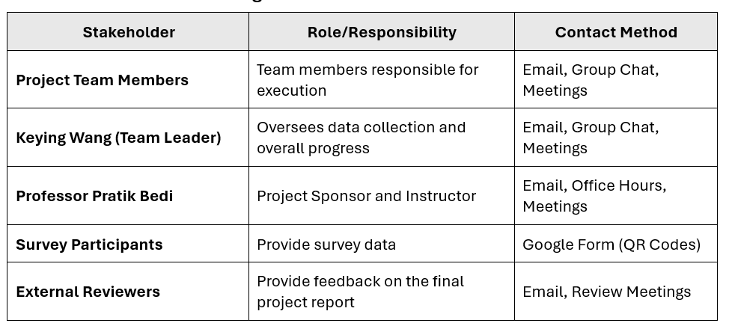
Stakeholder Register
This stakeholder register ensures clarity in roles, responsibilities, and communication channels, streamlining project execution and collaboration.

Slide 12
PROJECT PLANNING

Slide 13
Project Planning
1
Initiation
The project will be broken down into clear phases: initiation, planning, execution, monitoring, controlling, and closure. Each phase will consist of specific deliverables that will undergo a review and quality assurance process.
Define scope, objectives, team assignments, and project approval.
2
Survey Design & Pilot
Defined survey design process with flexibility in adjustments based on feedback.
3
Data Collection Phase
Structured collection process, with iterative adaptations based on early results.
4
Exploratory Data Analysis
Iterative exploration of data to refine hypotheses and analytics techniques.
5
Predictive Modeling Phase
Sequential development and refinement of predictive models based on analysis.
6
Final Report

Slide 14
Activity | Stakeholder(s) Involved | Description | Method of Communication | Frequency/Deadline
Sending Survey for Feedback | Survey Participants, Project Team | Survey feedback to improve quality | Email, Google Form (QR Codes) | By October 10th, 2024
Weekly Progress Reports | Project Team, Professor Pratik Bedi | Regular updates on project progress | Email | Weekly
Milestone Review Meetings | Project Team, Professor Pratik Bedi | Discuss progress and adjustments | Meetings, Email Reports | After each milestone
Survey Distribution Updates | Project Team, Professor Pratik Bedi | Updates on survey deployment | Email, Meetings | As needed
Final Review and Feedback | External Reviewers, Professor Pratik Bedi | Provide final feedback on the project | Presentation, Email | Before final submission
Final Presentation | Project Team, Professor Pratik Bedi, External Reviewers | Deliver final project findings | Presentation, Email | November 18th, 2024
STAKEHOLDER ENGAGEMENT PLAN

Slide 15
Project Scope
Inclusions
Exclusions
K-12 and higher education institutions, public and private schools, various subject areas, multiple assessment types.
Vocational training programs, adult education courses, and specialized educational institutions for students with disabilities.
Constraints
Assumptions
Limited to a 12-month study period, subject to data privacy regulations and ethical considerations.
Participants have reliable internet access, schools maintain consistent grading standards across modalities.

Slide 16
Work Breakdown Structure WBS
Impact of Online and Offline Education on Student Performance and Engagement
Planning and Initiation
Define project scope and objectives
Identify stakeholders
Create initial schedule and budget estimates
Conduct risk analysis and mitigation planning
Secure necessary resources (tool, software, personnel)
Requirements Analysis
Conduct stakeholder interviews
Define data requirements
Develop a data collection strategy
Create a project requirements document
Validate requrements with stakeholders
Data Gathering and Preprocessing
Design survey forms
Conduct pilot data collection
Full-scale data collection
Handle missing data and inconsistencies
Perform data cleaning and formatting
Data Exploration and Visualization
Conduct exploratory data analysis (EDA)
Generate summary statistics
Create visualizations for key matrics
Identify patterns and trends
Document insights and outliers
Implementation
Develop predictive models or analytics tools
Test models with subsets of data
Refine models based on performance
Deploy tools for stakeholder use
Monitoring and Maintenance
Track projet progress against milestones
Update stakeholders on developments
Adjust plans based on unforeseen issues
Ensure data and models remain valid during project
Report Generation and Documentation
Draft findings and conclusions
Prepare presentation materials
Develop actionable recommendations
Submit the final report to stakeholders
Archive all project files
Project Closure
Conduct a post-project review
Document lessons learned
Celebrate team contributions
Release project resources
Submit final documents and presentations

Slide 17
Gantt Chart
Task Name | Assigned To | Start (Date) | End (Date) | Duration (Days) | Percentage of Completion
Define survey questions | Phuong Tran & Ramandeep Singh | 28-Sep | 1-Oct | 3 | 100%
Test and finalize survey tool | Phuong Tran & Devansh Sharma | 2-Oct | 3-Oct | 1 | 100%
Generate and print QR codes | Devansh Sharma | 4-Oct | 5-Oct | 1 | 100%
Organize survey distribution at Riverside Campus | Keying Wang & Gaurav Singh | 6-Oct | 6-Oct | 0 | 100%
Conduct surveys at Riverside Campus | Ramandeep Singh | 7-Oct | 7-Oct | 0 | 100%
Conduct surveys at fitness center and cafeteria | Keying Wang & Phuong Tran | 8-Oct | 9-Oct | 1 | 100%
Clean and preprocess survey data | Phuong Tran | 11-Oct | 11-Oct | 0 | 100%
Perform statistical analysis | Keying Wang | 12-Oct | 13-Oct | 1 | 100%
Draft survey results | Ramandeep Singh | 14-Oct | 16-Oct | 2 | 100%
Review and finalize report | Keying Wang & Phuong Tran | 17-Oct | 17-Oct | 0 | 100%
Prepare final presentation | All team members (led by Keying Wang) | 6-Nov | 19-Nov | 13 | 100%

Slide 18
Gantt Chart

Slide 19
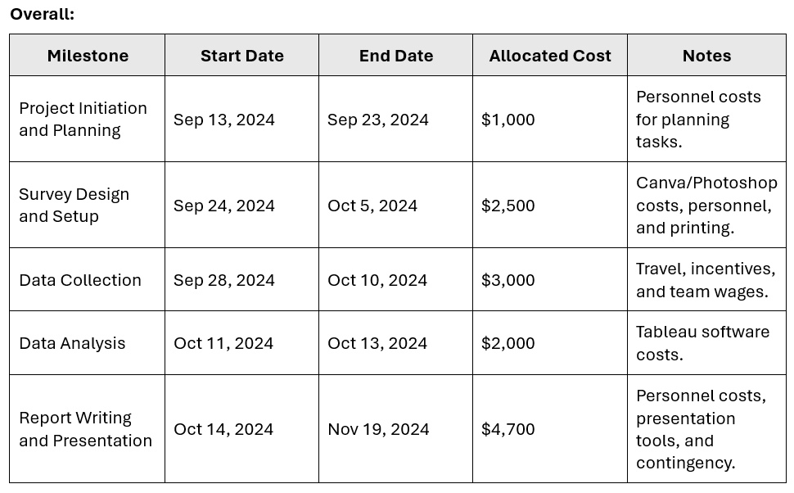
Cost and Budget Planning
Personnel Costs
Technology and Tools
62% of the budget. Includes team leader, researchers, data analysts, and support staff salaries, totaling $8,200.
13% of the budget. Covers Tableau licenses, Canva subscriptions, and data analysis tools like Python and Google Forms, totaling $1,700.
Logistics and Travel
Contingency
10% of the budget. Includes printing costs, participant incentives, and travel expenses for survey locations, totaling $1,300.
15% of the budget. Reserved for unforeseen expenses such as additional printing, software upgrades, or extra incentives, totaling $2,000.

Slide 20
Risk Identification & Assessment
Risk Identification
Survey Design: Errors in question clarity or relevance; insufficient pilot testing.
Data Collection: Low participation rates, QR code issues, limited access to participants.
Data Analysis: Poor data quality, integration challenges.
Reporting and Presentation: Delays in meeting deadlines.
Risk
Probability
Impact
Reasoning
Errors in survey question design
Medium
High
Poorly designed questions could
affect data accuracy and relevance.
Low Participation Rates
High
Medium
Students may not engage due to
survey fatigue or lack of incentives.
QR code distribution
issues
Low
Medium
Rare but possible, especially if QR
codes aren’t tested or printed correctly.
Limited student access
Medium
High
Students may be unavailable during certain times,
affecting sample size and representativeness.
Data quality issues
Medium
High
Incomplete or inconsistent data could
undermine analysis results and insights.
Delays in reporting
and presentation
Medium
Medium
Missed deadlines could affect stakeholder
trust and reduce the project’s impact.

Slide 21
PROJECT EXECUTION

Slide 22
Manage Project Work
Task | Assigned To | Start Date | Due Date | Status | Notes/Issues
Monitor team task performance | Keying Wang | September 13, 2024 | November 19, 2024 | Completed | Weekly updates provided in team meetings
Allocate tools and materials | Devansh Sharma, Keying Wang | September 13, 2024 | November 19, 2024 | Completed | Tools allocated (Google Forms, Tableau, etc.)
Conduct data validation | Gaurav Singh, Ramandeep Singh | September 28, 2024 | October 10, 2024 | Completed | Daily checks during data collection phase
Conduct quality assurance activities | Tran Bao Diem Phuong, Keying Wang | September 28, 2024 | November 19, 2024 | Completed | Weekly reviews of data collection and analysis methods
Resolve resource-related conflicts | Keying Wang | As Needed | As Needed | Resolved | Conflicts documented and resolved as necessary
Final progress reporting | Keying Wang, Tran Bao Diem Phuong | November 11, 2024 | November 18, 2024 | Completed | Final report sent to Professor Pratik Bedi

Slide 23
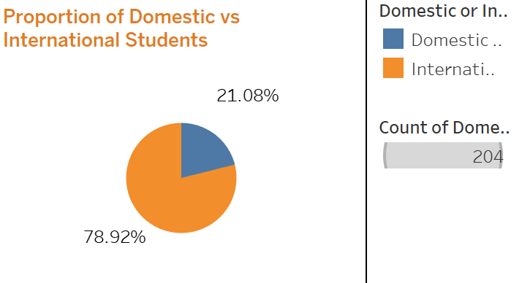
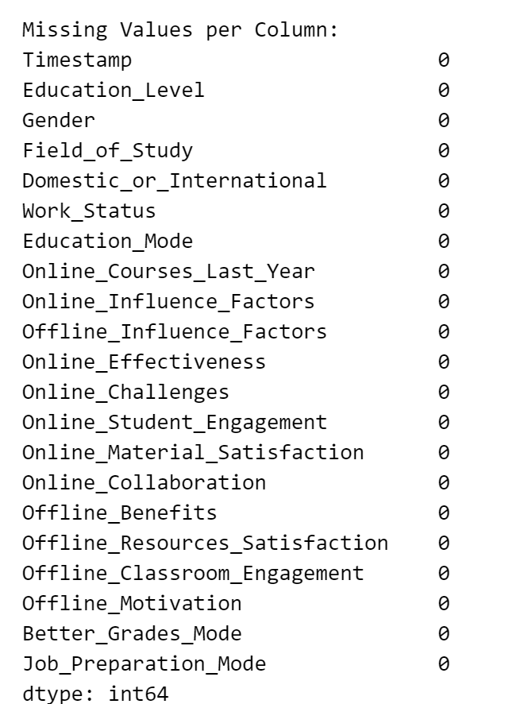
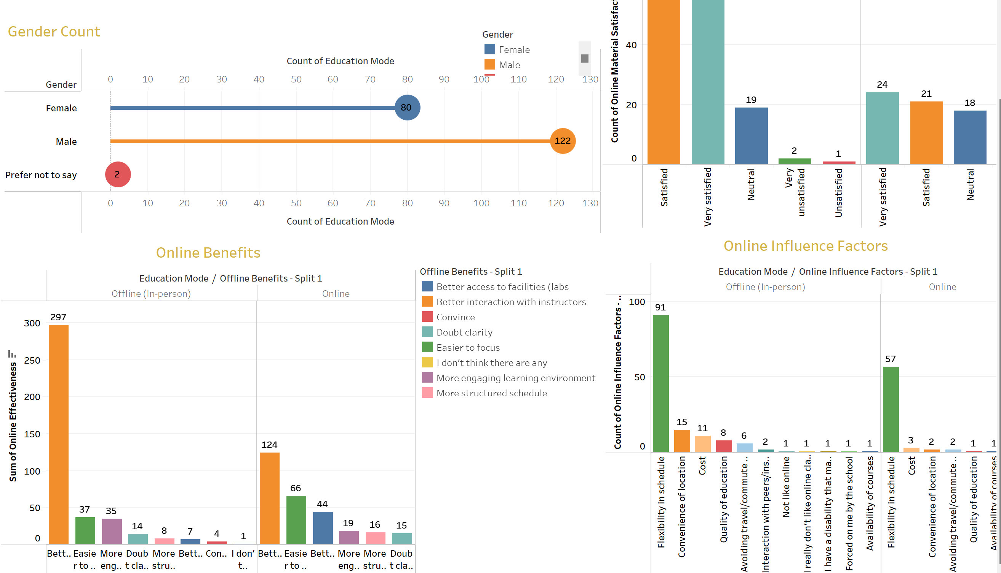
Data Collection and Analysis
Survey Design
205 questionnaires
80% from international students
20% from local students
1
Student Questionnaire
Assess learning experiences, engagement levels, and preferences for online vs. offline education.
2
Teacher Evaluation Form
Gather insights on teaching methods, challenges, and observed student performance across modalities.
3
In-Depth Interviews
Collect perspectives on student in St.clair learning progress and home study environment.
4
Data Analysis and Visulization
Integrate all collected data and perform visual analysis

Slide 24
Quality Management
Assurance Activities
Regular Review of Survey Design.
Validation of Collected Data.
Cross-checking and Audits.
The Quality Management Plan ensures all deliverables meet
predefined standards through systematic review and validation processes.
 | Quality Objectives | Responsibilities and Frequency
Survey Design | Ensure surveys are clear, effective, and reliable. | Conduct reviews after initial design and pilot testing.
Data Collection | Ensure data is accurate, timely, and consistent. | Daily validation during the data collection phase.
Data Analysis | Ensure final analysis meets required standards. | Weekly review of progress
Control Methods
Peer Reviews of Survey and Data Collection.
Audits of Collected Data.
Reporting Errors and Issue Resolution.
Final Report Review.

Slide 25



Resource Management
Resource work activities chart
Resource Allocation
September 28
- October 10
Survey Design
Personnel
Time
Finalize survey design after feedback.
Tasks assigned based on roles; monitor workload balance.
Assign realistic timeframes based on availability.
October 10
- October 20
Data Collection
Coordinate survey distribution and data collection.
October 10
- October 20
Data Validation
Ensure data accuracy and completeness.
October 20
- October 25
Data Analysis
Tools/Equipment
Physical Resources
Analyze collected data and identify insights.
Software and hardware to be used during project phases.
Ensure availability of physical resources during key phases.
October 25
- November 5
Report Writing
Write final report, incorporating data analysis findings.
November 5
- November 10
Final Presentation Preparation
Prepare for presentation to stakeholders.

Slide 26



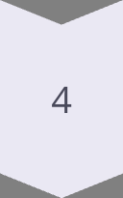
Resource Constraints
Constraint
Mitigation Strategy
Personnel
Adjust timeline, ensure workloads are balanced, and plan for overlapping tasks.
Limited availability of team members (e.g., during report writing phase).
Time
Monitor progress closely, break down tasks into manageable parts, and ensure buffer time for unexpected delays.
Tight project deadlines (e.g., for final report submission).
Tools/Equipment
Early acquisition of software licenses and scheduled training for team members.
Need for software tools like Tableau for visualization.
Physical Resources
Ensure timely procurement and pre-setup before starting data collection.
Limited access to QR codes or hardware.

Slide 27
RACI Matrix
Task | Project Leader (Keying Wang) | Survey Designer (Tran Bao Diem Phuong) | Tech Support (Devansh Sharma) | Data Collectors (Ramandeep Singh, Gaurav Singh) | Data Analyst (Tran Bao Diem Phuong) | Report Writer (Gaurav Singh)
Daily Check-ins | A | I | I | I | I | I
Weekly Progress Reports | A | I | I | I | I | I
Milestone Reviews | A | C | C | R | I | C
Issue Escalations | A | C | R | R | I | I
Final Presentation and Report | C | C | I | I | R | A

Slide 28
Manage Communication
Activity Description | Frequency | Channel | Target Audience | Responsible Party
Weekly Progress Updates | Weekly | Email, WhatsApp | Project Team, Stakeholders | Keying Wang (Team Leader)
Survey Feedback Integration | Post-survey completion | Email, Meetings | Stakeholders, Project Members | Tran Bao Diem Phuong
Bi-Weekly Data Insights Review | Every two weeks | Tableau Dashboards | Stakeholders | Ramandeep Singh
Stakeholder Engagement Workshops | Monthly (if required) | In-person, Zoom | Key Stakeholders | Project Team
Final Presentation & Delivery | At project completion | PowerPoint, On-site meeting | Stakeholders, Team, Instructors | All Members
Daily Coordination Updates | During critical phases | WhatsApp, Microsoft Teams | Project Team | Keying Wang
Risk Mitigation Briefings | Upon risk identification | Online Briefs (Google Drive) | Team Leaders | Ramandeep Singh, Devansh Sharma
Real-time Escalation Management | As issues arise | Microsoft Teams | Project Team | Tran Bao Diem Phuong
Milestone Reviews | At key project milestones | Microsoft Teams, Shared Docs | Stakeholders, Instructors | Ramandeep Singh
Final Reporting & Evaluation | Post-project | Shared Drive, In-person | Stakeholders, Academics | Gaurav Singh, Keying Wang

Slide 29
PROJECT MONITORING & CONTROLLING

Slide 30
Monitor project progress
Aspect | Steps to Monitor Project Progress and Performance
Define Key Milestones | Identify major milestones such as survey distribution, data cleaning, analysis, visualization, and report completion.
Progress Tracking | Used project management tools or tracking sheets to monitor key milestones like survey distribution, data collection, and analysis.
Real-time Monitoring | Track survey responses in real-time to ensure adequate participation within the set timeline.
Regular Updates | Provide weekly updates to stakeholders on the progress of key deliverables and any potential risks.
Risk Management | Maintain a risk register to document and address emerging risks such as delays in survey responses or data quality.
Performance Metrics | Measure performance against planned timelines, budget, and quality standards to ensure alignment with objectives.
Stakeholder Feedback | Incorporate stakeholder feedback at various stages to validate progress and ensure alignment with project goals.
Costs are tracked against the $13,200 budget outlined in the Project Management Plan. Variances in spending are logged and analyzed to identify the root cause of deviations. Adjustments are made through stakeholder consultation and approval to ensure the project remains financially sustainable. Weekly budget reports are shared with the project team to maintain transparency.

Slide 31
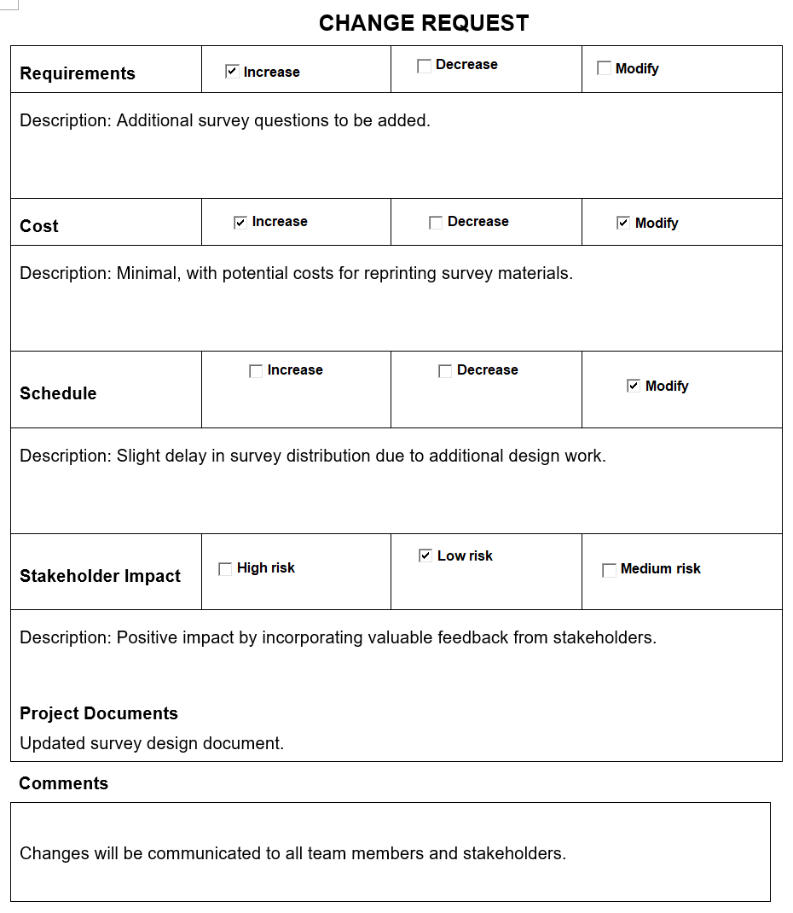
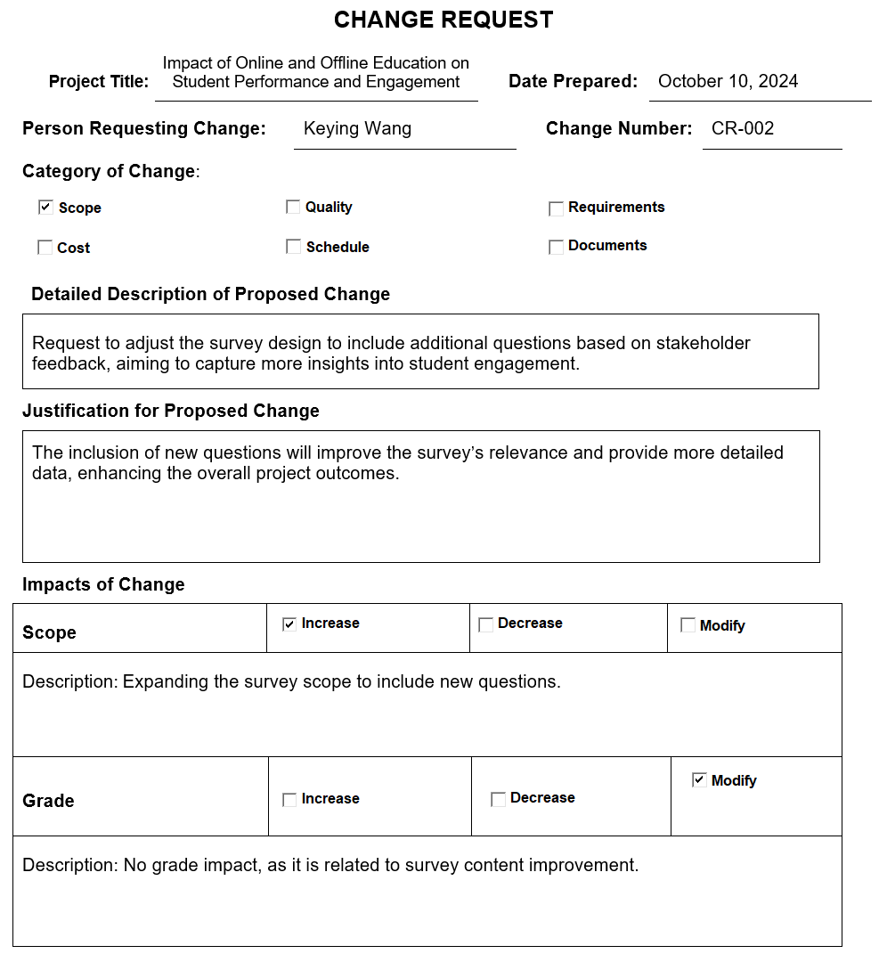
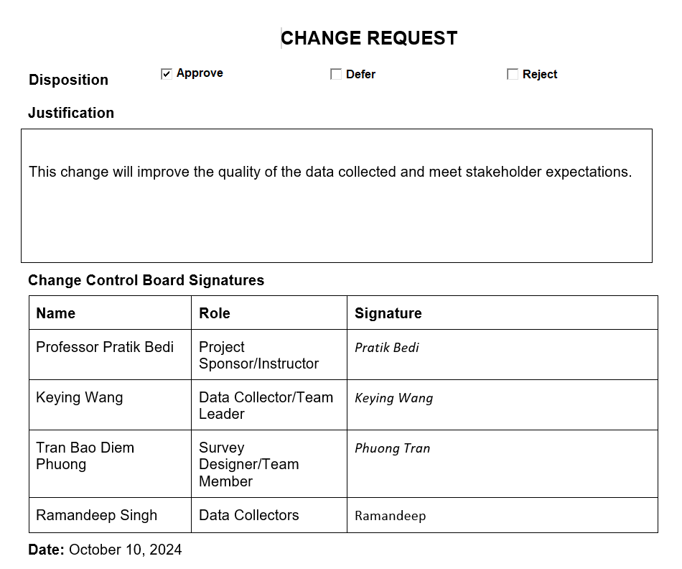
Change Request

Slide 32
Change ID | Category | Description of Change | Submitted by | Submission Date | Status | Disposition
CR-001 | Scope | Adjustment to survey design to include new questions based on stakeholder feedback. | Tran Bao Diem Phuong | September 30, 2024 | Approved | Changes incorporated into survey design.
CR-002 | Schedule | Extension of data collection deadline due to low participation rates. | Keying Wang | October 5, 2024 | Approved | Data collection deadline extended.
CR-003 | Resources | Additional QR codes required for extended data collection locations. | Devansh Sharma | September 28, 2024 | Approved | QR codes ordered and distributed.
Change Log

Slide 33
Change Control
Stakeholder Request
Impact Assessment
Decision
Change 1: Extend the survey distribution period to improve response rates.
Change 2: Add additional questions about hybrid education preferences to the survey.
Assessed the impact of both changes on project scope, timeline, budget, and objectives.
Evaluated feasibility and potential risks associated with each requested change.
Change 1 (Approved): The survey distribution period was extended by one week to ensure sufficient responses.
Change 2 (Rejected): Adding new questions was declined to maintain data consistency and avoid delays.
Implementation of Change
Communication
Adjusted project schedule to accommodate the extended survey period.
Sent reminders during the extended period to boost participation while maintaining other timelines.
Communicated the decision to the stakeholder, explaining the rationale for approval/rejection.
Updated the project plan and shared revised timelines with the project team and stakeholders.

Slide 34
Validate Project Scope
Scope Validation
Aspect | Description
Scope Control: | - Regularly reviewed progress to ensure that all deliverables were within the defined scope. - Managed scope changes through a formal change control process.
Schedule Control: | Monitored project milestones and adjusted timelines as necessary, such as extending survey distribution period to accommodate more responses.
Cost Control: | Tracked budget expenditures, ensuring the project remained within the $13,200 budget.
Quality Control: | Conducted quality checks at each stage of the project, including survey design, data cleaning, and analysis, to ensure deliverables met the required standards.
Resource Control: | Assigned roles within the team and ensured that the required tools and expertise were available to the project.
Stakeholder Approval
Deliverable Review
Documented Validation
Feedback Incorporation
Outcome Confirmation
Validate project scope

Slide 35

Quality and Procurement Control
1
Quality Control
2
Procurement
Enhancements
3
Reinforced by peer reviews and milestones.
Addressed issues promptly with documentation.
Tools: Tableau licenses, QR codes.
Monitoring: Weekly status updates to mitigate delays.
Real-time procurement updates ensure minimal disruptions.

Slide 36
PROJECT CLOSURE

Slide 37
Final Review
Main Task | Describe
Final Data Analysis & Reporting | Comprehensive analysis of project data, including insights on crop production, AI performance, and environmental factors.
Evaluation of Project Success | Overall performance assessment against predefined success criteria to evaluate the achievement of project objectives.
Lessons Learned Documentation | Record the project's successes, challenges, and actionable recommendations for future projects.
Stakeholder Feedback & Review | Collect stakeholder perspectives on the project's outcomes and address concerns or suggestions.
Resource & Budget Reconciliation | Ensure adherence to the initial plan and identify any variances for future reference.
Formal Project Closure | Final report including a summary of achievements, challenges, and recommendations for improvements or follow-up initiatives.
Dissemination of Results | Share project findings with relevant stakeholders, agricultural communities, and research institutions to promote AI-driven agricultural practices.

Slide 38
LESSONS LEARNED | What Worked Well | What Can Be Improved
Requirements definition and management | Stakeholders provided timely input on requirements, improving clarity. | Conduct more detailed requirement reviews to avoid mid-project adjustments.
Scope definition and management | Clearly defined inclusions, exclusions, and assumptions avoided scope creep. | Define contingency plans for unexpected changes to scope.
Schedule development and control | Gantt chart provided effective tracking of tasks and deadlines. | Allocate additional buffer time for high-risk tasks like data collection.
Cost estimating and control | Budget adherence ensured by regular monitoring and prioritization. | Incorporate a more flexible contingency fund for unexpected costs.
Quality planning and control | Weekly reviews ensured deliverable consistency and quality. | Conduct more frequent quality checks during data collection to reduce errors.
Human resource availability, team development, and performance | Team roles and responsibilities were well-defined and effectively executed. | Improve resource allocation during peak phases like data collection.
Communication management | Weekly updates and clear channels minimized misunderstandings. | Provide more real-time updates during critical phases like survey launch.
Stakeholder management | Stakeholder feedback was incorporated promptly into deliverables. | Engage stakeholders earlier to avoid last-minute changes.
Reporting | Tableau visualizations enhanced clarity and impact of reporting. | Provide earlier drafts of reports for stakeholder review to minimize revisions.
Risk management | Risk register and weekly reviews effectively tracked potential risks. | Proactively address risks related to low survey participation earlier.
Procurement planning and management | Timely acquisition of tools like Tableau avoided delays. | Diversify vendor options for key resources like printed QR codes.
Process improvement information | Agile iterations improved responsiveness during data analysis. | Refine process documentation for smoother future execution.
Product-specific information | Survey design successfully captured actionable insights. | Pilot testing revealed areas for improvement but could be expanded.
Other | Team collaboration was strong, ensuring smooth execution. | Improve tracking of individual task completion in shared platforms.

Slide 39

Stakeholder Approval Process
1
Deliverable Presentation
Share the final report, data visualizations, and recommendations
with stakeholders for evaluation.
2
Stakeholder Feedback Collection
Address issues or suggestions raised by stakeholders to ensure expectations are met.
3
Formal Sign-off
Obtain official or written consent from stakeholders confirming that deliverables meet predefined goals.
4
Document Outcomes
Prepare a comprehensive report summarizing key achievements, challenges, and lessons learned.
4
Archival
Safely store all project-related records, data, and visualizations for audits or future reference.

Slide 40
Contract Closure Process
Step
Description
Contract Review
Examine all contracts with suppliers and vendors to make sure all conditions and deadlines have been fulfilled.
Final Payments
Complete any outstanding payments for software or tools that were utilized, like as licenses for Tableau.
Documentation
Track contract closure details, including invoices, receipts, and fulfillment statements.
Confirmation
Get confirmation from suppliers or vendors that the deal has been closed effectively.

